Slide 1
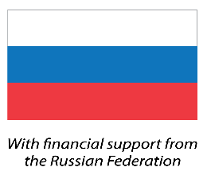
Climate Box
Module 2
Topic 2.1.2.2 Recommendations for organization, preparation and hosting оf competitions of different levels (school, city, regional) for schoolchildren’s projects on climate change, its consequences and adaptation ways
Программа развития ООН
2020

Slide 2
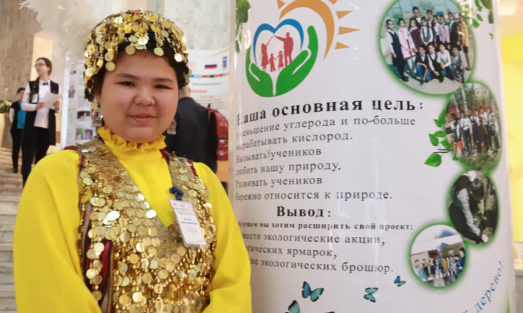
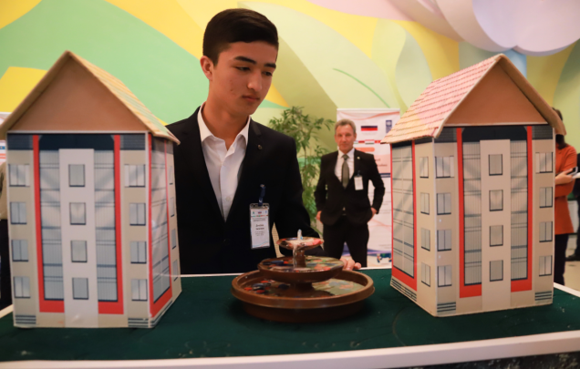
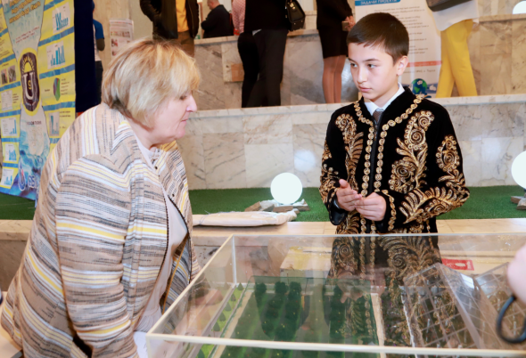
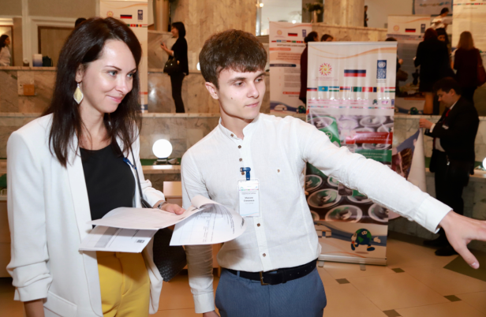
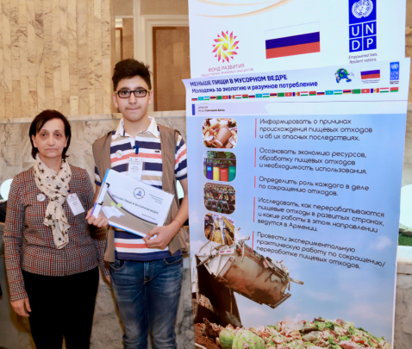
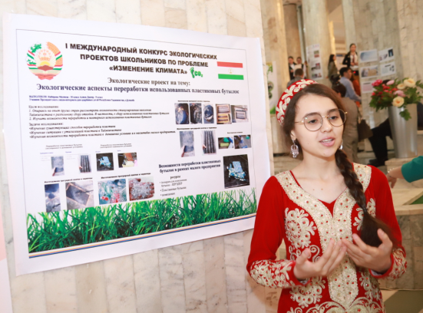
INTRODUCTION. WHAT IS THE COMPETITION
OF SCHOOLCHILDREN’S PROJECTS FOR?
Improving quality of schoolchildren’s projects;
Creating a motivating educational space;
Platform for new opportunities:
Creating horizontal ties among project participants;
Building professional relations between professional community representatives;
Expanding and popularizing of the created projects;
Involving new participants in the project activities;
Encouraging both projects’ authors and research advisors through public recognition.
2

Slide 3
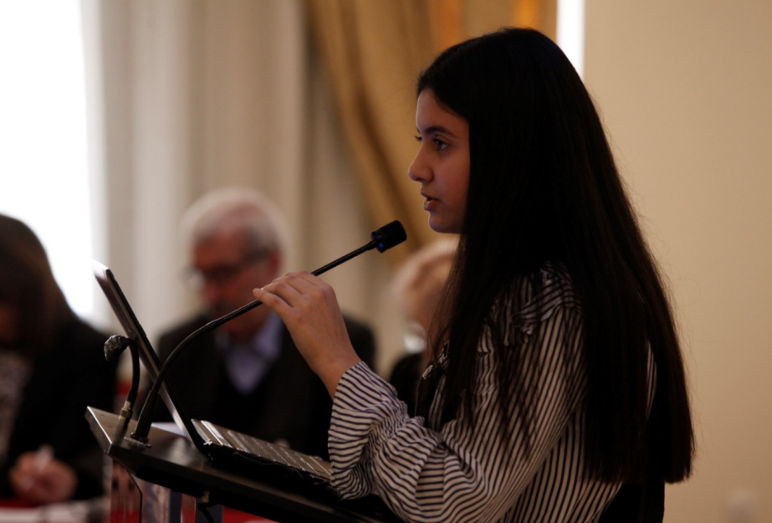
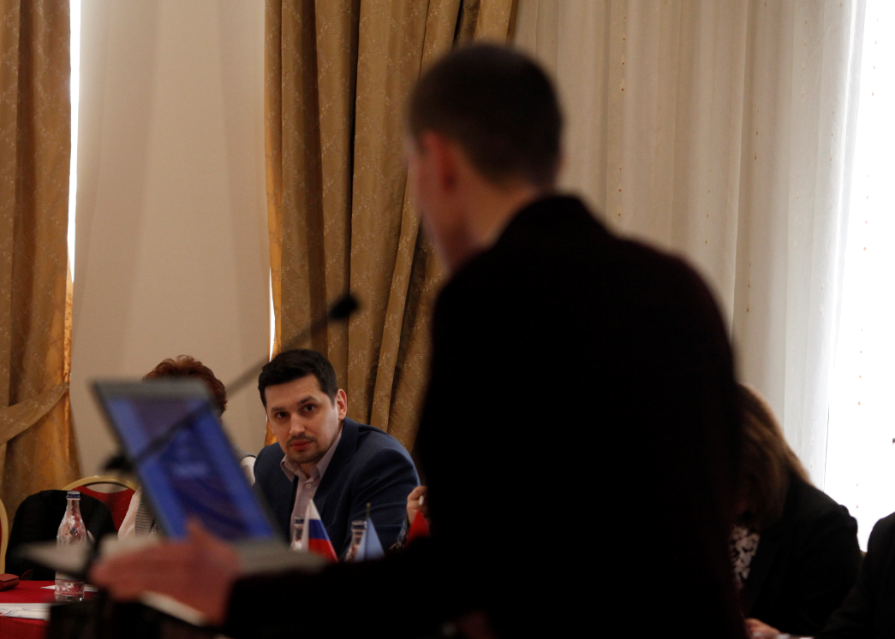
COMPETITION FORMAT.
The competition can be presented in the following formats:
A separate independent event with its own regulations, which has separate competition founders (local education administration, school governing council, methodological association of teachers, etc.);
A separate independent section within the existing similar competition with introducing appropriate changes to the competition regulations;
The competition can be organized only at the school level or with the subsequent selection of the best projects and their promotion to the city competition and further to regional and national competitions.
3

Slide 4
PREPARATION FOR THE COMPETITION
It is recommended to form the following controls:
The competition appeals commission (participants who do not agree with the result of individual stages can send their objections and receive a reasoned response on behalf of the organizing committee);
An expert commission (projects’ evaluation from the stage of processing applications to further face-to-face presentation).
Publication announcing the competition:
Deadline for accepting applications (interval of at least one month);
Email or personal account;
An excerpt from the regulation on the projects’ requirements, the main objectives of the competition (solving problems or preventing global climate change and adapting to its consequences);
Requirements for participants and papers;
Evaluation criteria and participation format.
Competition Documents:
Competition regulation;
List of documents for filing an application:
Consent to personal data processing;
Project theses (summary, name, purpose, objectives, project stages, conclusion, results);
Full paper text;
Presentation.
Organizing committee work and functions:
Applications’ accepting and processing;
Dividing participants to age categories;
Distribution of the submitted projects among the competition experts;
Providing feedback to the competition participants.
4

Slide 5
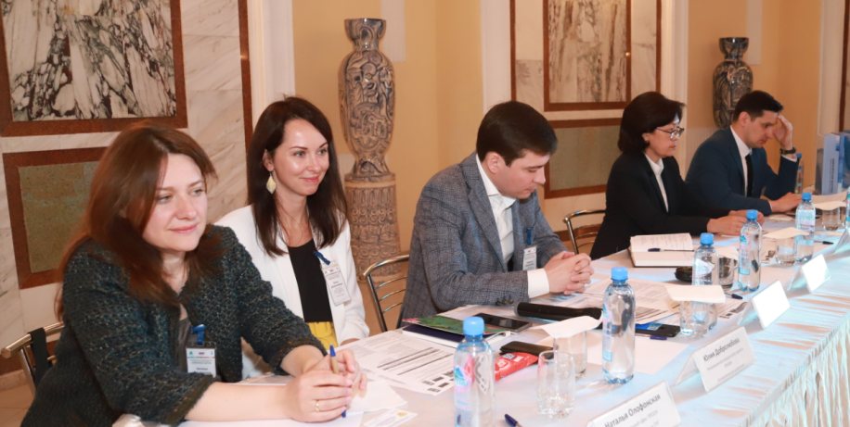
PROJECT EVALUATION CRITERIA
The more objective and uniform the experts’ way of evaluating projects is, the more joy the event will bring to both organizers and participants!
Relevance – validity of knowledge of global climate change problems, knowledge is based on modern scientific data, the global climate change consequences are assessed in general for the planet, humanity and for the area where the project is being implemented (region, city, village), the goal is achievable, tasks are being solved "here and now", practical activities have been carried out;
Planning – the resources involved are indicated and feasible for the participants, the project implementation stages are planned and carried out and have the content corresponding to the competition topic (climate, consequences, adaptation, actions to reduce climate impact),
Product – the project contribution to solving the problem of climate change is demonstrated:
the amount of reduction in greenhouse gas emissions or their absorption – for example, for greening projects, is calculated;
adaptation mechanisms have been developed to reduce the effects of global climate change (drought-resistant plant varieties have been introduced, сконструированы salt water desalination plants have been designed for coastal arid regions etc.);
4

Slide 6
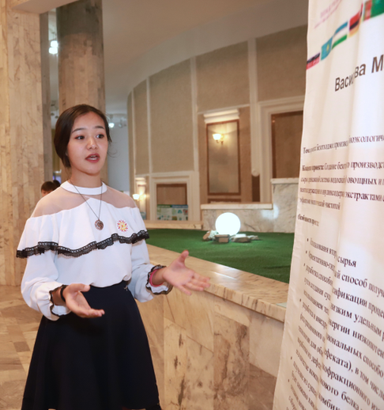
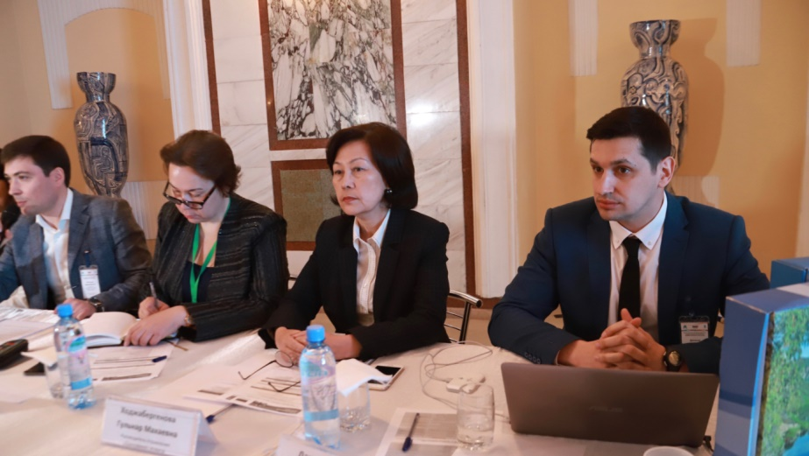
КРИТЕРИИ ОЦЕНКИ ПРОЕКТНЫХ РАБОТ
The more objective and uniform the experts’ way of evaluating projects is, the more joy the event will bring to both organizers and participants!
Speech – during the project presentation the author actively uses the Climate Box textbook terminology, the speech reflects all the necessary sections of the work (relevance, purpose, tasks, materials and methods, results), the author confidently answers questions asked by experts, reports live;
Visual Influence – the presentation (stand) is not overloaded with text, the illustrations are copyrighted, appropriate, additional visual materials are presented.
4

Slide 7
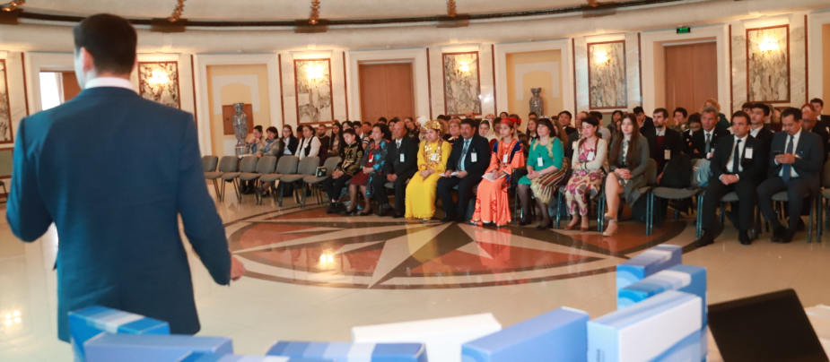
METHODS OF PROJECT PRESENTATION. CONCLUSION
It is recommended to accept all competition documentation in electronic form by mail or a personal account;
After the selection of best projects, it is worth distinguishing the group of authors admitted for public presentation;
Additionally, groups can be organized according to the
following criteria:
Age;
Adaptation to global climate change and its consequences;
Combating the global climate change causes (greenhouse gas emissions).
3. Project presentation formats :
In person;
By videoconference (by broadcasting on open Internet platforms).
If the competition provides for several stages (city, regional, national), then the experts evaluating the work must select the 3 strongest projects to promote their authors to the next stage;
If the competition is limited only to the school stage, then it is worth encouraging all authors by awarding appropriate nominations (the best village project, the best urban project, the best project for adaptation to climate change, etc.).;
At the competition stages with no promotion to the next stage provided for, it is also recommended to encourage all participants, awarding the authors in individual nominations.
4

Slide 8
LIST OF ILLUSTRATIONS
The photos and illustrations used in the module, where sources are not specified, are either taken from the Climate Box toolkit (see the List of illustrations at the end of the textbook) or provided by the program participant.
18

Slide 9
THANK YOU FOR LISTENING!
Программа развития ООН
2020

