Slide 1
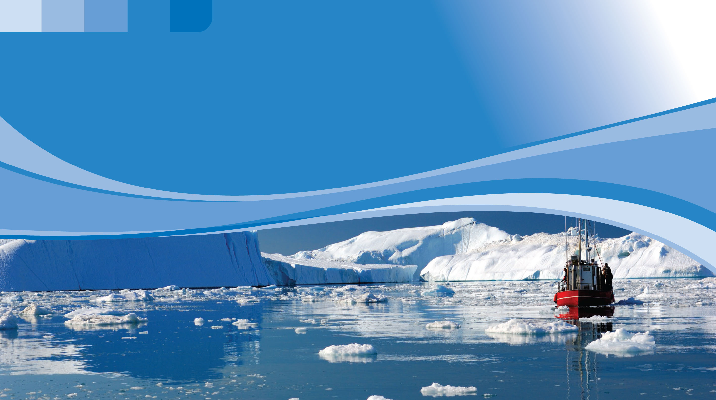
Module 2.
Topic 2.2.1. Examples and plans of thematic and interdisciplinary lessons using interactive learning toolkit «Сlimate box"
Biology lesson "Biodiversity is the result of organic evolution"
Author: Irina Novoselova, biology and geography teacher, Russian Federation
UNDP
2020

Slide 2
BIOLOGY CLASS
I. Today's lesson. "Biodiversity is the result of organic evolution"
II. The purpose of the lesson.
To show the role of biodiversity in retention of stability of ecosystems and how stability can be disrupted due to climate change, to instil responsibility for the consequences of their actions, and to develop critical thinking.
III. Lesson plan.
- getting new knowledge about the role of various factors affecting biodiversity;
- getting new knowledge about the impact of climate change on biodiversity and the most vulnerable animal and plant species;
- getting new knowledge about the importance of biodiversity for maintaining ecological balance in nature;
- education of environmental and climate literacy, formation of a civil position and responsible attitude to the environment.
IV. Type and form of the lesson: Introduction to new material; conversation, lecture.
V. Equipment.
Presentation "Biodiversity is the result of organic evolution";
Map: "Natural Area";
Interactive learning toolkit "Climate Box".
2

Slide 3
VI. Course of the lesson:
1. Organisational aspect.
The teacher's action | The students' action
Checking students' preparation for the class, availability of textbooks and notebooks. | Prepare the workplace, notebooks, pens, pencils for the lesson.
2. Checking homework.
Conducts a survey of students on learned material: The biosphere is....? Evolution is ....? Species are...? Population is...? What is the biotic community and what kinds of communities do you know? | Students answer the questions.
3. Actualization of knowledge.
Topic-based conversation. We are surrounded by a great world of various living creatures such as plants, animals, and microorganisms that form a variety of combinations in different parts of our planet. What do you think about whether species have changed in different epochs of Earth's history? Why? Are all natural areas equally populated with plants and animals? Where is the living world as diverse as possible in terms of the number of species? Why? | Conversation with students. They answer questions and argue for answers.
3

Slide 4
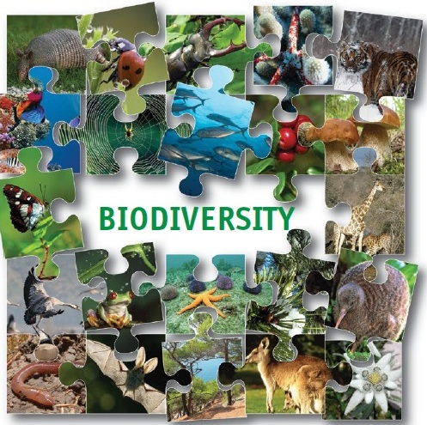
VI. Course of the lesson:
4. Lesson plan. Questions to study.
1. What is biodiversity?
2. Taxonomic diversity of the animal world of the earth.
3. Factors affecting biodiversity, including climate change.
4. Evolution of biodiversity.
5. Decrease in biodiversity under human influence.
6. How to preserve biodiversity.
4

Slide 5
VI. Course of the lesson:
5. The main part.
Question 1. | Materials from the "Climate Box":
 | Section 2.2. How climate change affects plants and animals.
1. What is biodiversity? Types of biodiversity: genetic; species; landscape or ecosystem. All types of biological diversity are interconnected. The diversity of ecosystems and landscapes makes conditions for the formation of new species. Increasing species diversity increases the overall genetic potential of living organisms in the Biosphere. Each species contributes to diversity. Biodiversity plays a crucial role in the stability of the biosphere, from which people get the resources for their existence. | Topic: What is biodiversity? Why biodiversity is so important. Biodiversity plays a crucial role in the stability of the biosphere, from which people get the resources for their existence. Hence the importance of rational use of the plant and animal genofond in combination with its long-term conservation, this aim can be achieved only with a clear understanding of the processes occurring in the biosphere, the relations and interdependencies between the components of ecosystems. (UN conference on environment and development, Rio de Janeiro 1992).
Question 2.
Taxonomic diversity of the animal world of the earth. | -
5
Notes:
1. What is biodiversity?
Types of biodiversity: genetic; species; landscape or ecosystem.
All types of biological diversity are interrelated: genetic diversity provides diversity of species. The diversity of ecosystems and landscapes makes conditions for the formation of new species. Increasing species diversity increases the overall genetic potential of living organisms in the Biosphere. Each species contributes to diversity. From this point of view, there are no useless and harmful species.
The study, use and conservation of biodiversity has received much attention since many States signed the Convention on biological diversity (UN conference on environment and development, Rio de Janeiro 1992).
Biodiversity plays a crucial role in the stability of the biosphere, from which people get the resources for their existence. Hence the importance of rational use of the plant and animal genofond in combination with its long-term conservation, this aim can be achieved only with a clear understanding of the processes occurring in the biosphere, the relations and interdependencies between the components of ecosystems, and above all from the knowledge of the diversity that surrounds us.
Taxonomic diversity of the animal world of the earth.
After the systematization of Carl Linnaeus (1758), new species continue to be discovered and appear. Demonstration of the table: the number of species in groups of animals.
The number of animal species varies in different parts of the world.
In the direction from even land to high latitudes and high altitudes of mountain ranges is clearly visible the decrease in diversity. This phenomenon is called the main gradient of diversity. (Students see on the map "Natural Zones", how the plant and animal world changes depending on a particular natural zone).

Slide 6
VI. Course of the lesson:
Question 3. | Materials from the "Climate Box":
 | Section 2.2. How climate change affects plants and animals.
Factors affecting biodiversity. Why did evolution take place differently in the tropics and beyond the Arctic Circle, on the plains and in the highlands, in shallow waters and in the deep depressions of the World's Oceans? Let's see hypotheses that explain biological diversity. - evolutionary time. - environmental time. - the stability of the climate, seasonal fluctuations. | Topic: What are the threats to biodiversity? In addition to human economic activity, changes in natural conditions such as temperature changes, forest fires, melting of permafrost, drainage of wetlands, fluctuations in the level of the World Ocean, etc. have a significant impact on biodiversity.
Question 4.
Evolution of biodiversity. In the history of the organic world, there were periods of growth and decline of biodiversity, when some groups of organisms entered the life, replacing others. | Topic: Great extinctions and climate change. There are five major "great extinctions" related to climate change. After the extinction, life was restored, but it wasn't at all like the old one. It took millions of years to restore.
6
Notes:
Factors affecting biodiversity.
Issue of concern. If biological diversity is the result of evolution, why did evolution take place differently in the tropics and beyond the Arctic Circle, on the plains and in the highlands, in the shallow waters and in the deep depressions of the World's Oceans?
Let's see hypotheses that explain biological diversity.
- The diversity of the animal world increases with the age of the communities in which the species live. That is the evolutionary time.
- The time required for species resettlement, but not for speciation is ecological time.
- The most common hypothesis connects species wealth with climate stability, with its slight seasonal variations.
Biodiversity is affected by complexity of habitat structure; productivity of habitats; competition; predation.
The climate box. In addition to human economic activity, changes in natural conditions such as temperature changes, forest fires, melting of permafrost, drainage of wetlands, fluctuations in the level of the World Ocean, etc. have a significant impact on biodiversity.
4. Evolution of biodiversity.
In the history of the organic world, there were periods of growth and decline of biodiversity, when some groups of organisms entered the life, replacing others.
The climate box. Great extinctions and climate change.
For the entire period of development of wildlife known to modern science (more than 3 billion years), there were several dozen periods of sharp climate changes that led to a meaningful decrease in biodiversity. Among these segments, there are five that are particularly distinguished, that are name the great extinctions. After the extinction, life was restored, but it wasn't at all like the old one. It took millions of years to restore.

Slide 7
VI. Course of the lesson:
Question 5. | Materials from the "Climate Box":
 | Section 2.2. How climate change affects plants and animals.
Decrease in biodiversity under human influence. The extinction of animal species occurred throughout the history of the animal world, but this process was extremely slow, over geological periods of time. One of the major reasons for the decrease in biodiversity is the reduction of the total area of small species' habitat due to anthropogenic activities. This leads to a destructive chain-type reaction that begins with the probable loss of rare species. The rarity of a species is the best indicator of its vulnerability. | Topic: Which of the animals before the other responds to climate change. In the last century, under the influence of human activity and dramatic climate change, the rate of extinction of species across the planet is many times higher than natural. Examples: the reduction of the Northern Polar ice cap threatens the population of polar bears, seals, Arctic foxes and other Arctic animals. The habitats of tundra animals such as deer and lemmings are changing. In other parts of the world, lakes and small rivers disappear, forest belts dry up, and plains burn out earlier than usual. All this is a threat to some species.
Question 6.
How to preserve biodiversity. | Topics: How to preserve biodiversity. National park. Wildlife reserves. Ecotourism: harmony of nature and man. What is the Red Line and what is it for?
7
Notes:
5. Decrease in biodiversity under human influence.
The extinction of animal species occurred throughout the history of the animal world, but this process was extremely slow, over geological periods of time, and in no way compares with the rate of extinction under the influence of anthropogenic pressure on the biosphere.
We know quite well about the devastation of fauna, if we are talking about large and noticeable animals. But the threat to all the systems that support our life is associated with the disappearance of countless populations of inconspicuous organisms that died during plowing, open mining, filling the soil with waste, processing pesticides, etc.
One of the major reasons for the decline in biodiversity is the reduction of the total area of species' habitat. This leads to a destructive chain-type reaction that begins with the probable loss of rare species. The rarity of a species is the best indicator of its vulnerability.
From the "Climate Box" Which of the animals before the other responds to climate change.
In the last century, under the influence of human activity and dramatic climate change, the rate of extinction of species across the planet is many times higher than natural. Examples from the "Climate Box": the reduction of the Northern Polar ice cap threatens the population of polar bears, seals, Arctic foxes and other Arctic animals. The habitats of tundra animals such as deer and lemmings are changing. In other parts of the world, lakes and small rivers disappear, forest belts dry up, and plains burn out earlier than usual. All this is a threat to some species.
6. How to preserve biodiversity.
- based on "Climate Box" materials.
Examples of specially protected natural areas are wildlife reserves, national parks, etc.

Slide 8
VII. Solve a situational problem to solidify the material.
Questionnaire:
What is biodiversity?
What are the factors that affect biodiversity?
How does biodiversity decrease under human influence?
How to preserve biodiversity.
Situational issue:
By moving polar bears, scientists can most clearly assess how the climate is changing. Analysis of the bears movement showed that they clock up about 80-100 kilometers per month, moving mainly along the coasts, and they go no further than one or two kilometers inside the continents. But the appearance of some of them has been repeatedly noticed.
How can this behavior of polar bears be explained?
What is the threat to their population?
8

Slide 9
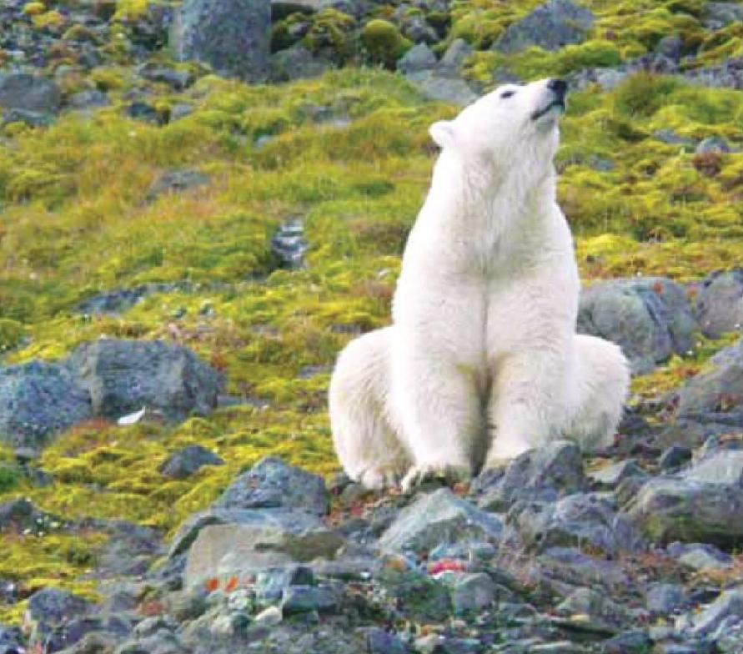
VII. Solve a situational problem to solidify the material.
Correct answer. Argument.
The main food for polar bears is a seal on an ice floe. They don't really need land, they just build dens on it and breed their offspring. But the ice is rapidly melting, retreating from the coastline further and further. And all the longer the sea is free of ice. Bears are not adapted to hunting in water. They have to look for food on the shore, something's like dead birds, eggs of small animals. Despite the fact that polar bears are still trying not to go deep into the continents, hunger is increasingly forcing them to look for food wherever it's possible.
These factors make the polar bear population vulnerable to warming and can lead to a severe decline in numbers, and possibly complete extinction.
9

Slide 10
VIII. Lesson summary (reflection).
What did you learn in the class?
What plants and animals do you know in our region that are in decline?
What is the reason for this?
What we can do to save them.
VIX. Home assignment.
Prepare a report on one of the animal or plant species whose populations are most vulnerable to climate change. What you can do to save it.
10

Slide 11
THANKS FOR YOUR ATTENTION!
UNDP
2020

